Slide 1

Classifying Personalities (4P)

Slide 2
01
Introduction

Slide 3
1
About our dataset
2
3
2
What is our goal?

Slide 4
Proposed approach
Challenges
EDA
Model
Data Cleaning

Slide 5
How did we achieve our goal?
Dataset
1
diplomat
Explorer
analyst
Sentinel
In order not to have a lot of classes to classify ,we found that we can categorize the classes into 4 main personalities .

Slide 6
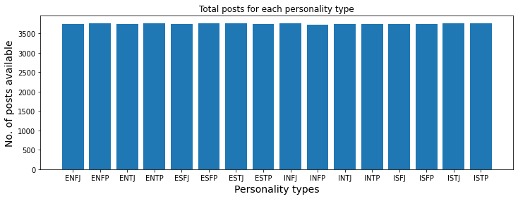
The data before we categorized it

Slide 7
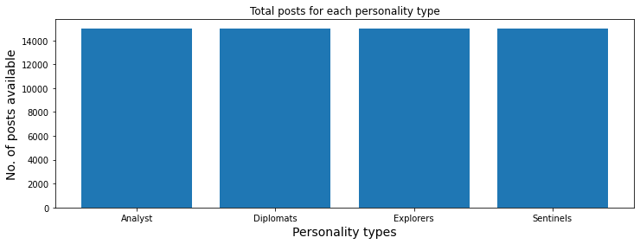
Data after we categorized it to 4 personalities types

Slide 8
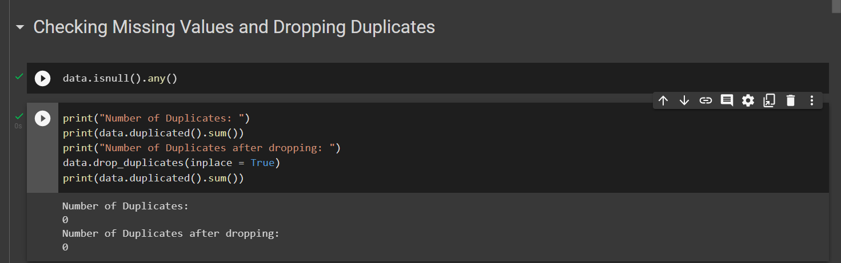
We checked for missing values and dropped the duplicates

Slide 9
As for the modelling
we used :
1)Decision tree
2) XGBoost
3)SVM
4)Naïve Bayes
5)KNN

Slide 10
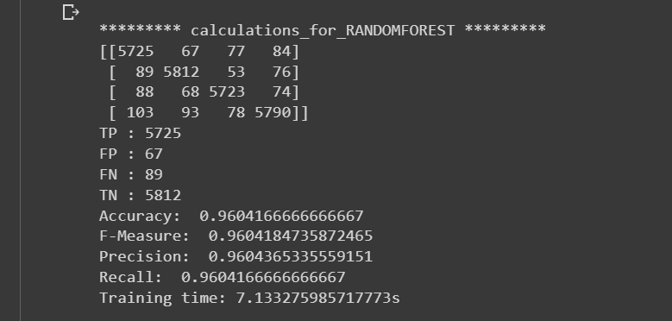
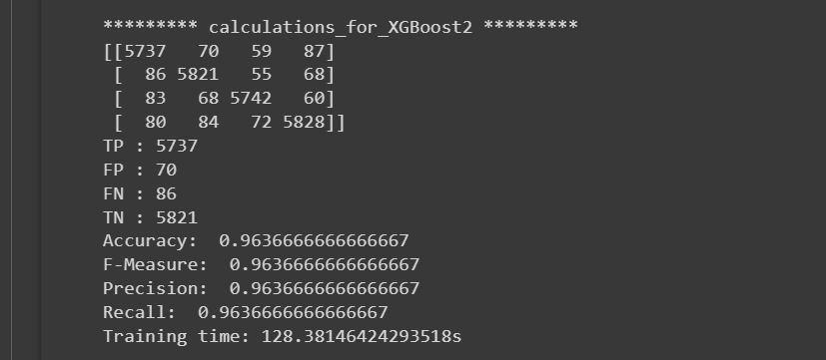
The best 2 with the highest accuracy
XGBoost
Random Forest

Slide 11
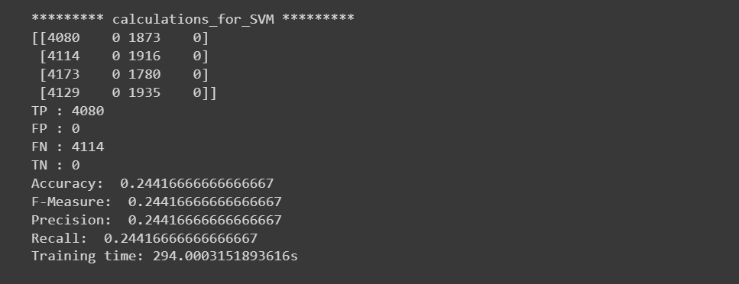
Least accuracy
SVM

Slide 12
Conclusion

Slide 13
After we have evaluated the classification models that we applied to the dataset, XGBoost model gave the best accuracy, which is 96.7%.
The second-best model was the random forest with accuracy of 96.2%.
Unfortunately, the problem that we faced was the time consumption it took the XGBoost model to fit it to the testing data. In contrast, random forest model took a lot less time to fit the model.
In conclusion, we have found that the best classification model for the personality dataset was the random forest model.

Slide 14
Thank you☺
Data Mining
Dr. Nailah Almadi
Prepared By:
DONE BY: Jessica Abueledam 20200137 Sondos Ali 20200438

